Slide 1


Introduction to the Systematic Approach
Conducting investigations requires a thoughtful, step-by-step process to ensure thorough and effective results. A systematic approach provides a structured framework to guide the investigation from start to finish, leading to more reliable conclusions.

Slide 2



Defining the Scope and Objectives
Scope
Objectives
Planning
Clearly define the boundaries of the investigation, including the timeframe, geographical area, and specific issues or events to be examined.
Establish clear, measurable objectives that will guide the investigation and ensure it addresses the key questions or concerns.
Develop a detailed plan of action, outlining the steps, resources, and timelines needed to effectively carry out the investigation.

Slide 3

Gathering Relevant Information
Gathering relevant information is crucial in a systematic investigation. This step involves thoroughly researching the issue, collecting data from reliable sources, and identifying any gaps or inconsistencies in the available information.
Investigators should consider a wide range of sources, including documents, interviews, physical evidence, and digital records. Careful documentation and organization of the gathered information is essential for effective analysis.

Slide 4



Analyzing the Evidence
Scrutinizing the Details
Forensic Analysis
Meticulous Documentation
Carefully examine all available information and data, leaving no stone unturned. Identify any patterns, anomalies, or inconsistencies that could provide valuable clues.
Utilize sophisticated techniques and technologies to thoroughly test and evaluate the physical evidence. Extract every bit of insight to build a comprehensive understanding of the situation.
Meticulously document each step of the analysis process, ensuring a clear and traceable record. This will form the foundation for drawing conclusions and presenting findings.

Slide 5
Identifying Potential Causes
Examine the Evidence
Consider Multiple Factors
Brainstorm Possibilities
Prioritize Plausible Causes
Carefully analyze the information gathered to identify any patterns, anomalies, or inconsistencies that could point to the root cause of the issue.
Look beyond the obvious and consider how various environmental, procedural, or human factors may have contributed to the problem.
Engage in an open-minded brainstorming session to generate a list of potential causes, no matter how unlikely they may seem at first.
Evaluate each potential cause based on the available evidence and likelihood, focusing your efforts on the most promising leads.

Slide 6
Developing Hypotheses
Identify Potential Causes
1
Analyze the information gathered to pinpoint possible factors contributing to the issue.
Formulate Hypotheses
2
Develop educated guesses about the underlying causes based on the evidence.
Prioritize Hypotheses
3
Rank the hypotheses in order of likelihood to focus the investigation.
With the relevant information collected, the next step is to develop a set of hypotheses that could explain the underlying causes of the issue under investigation. This involves carefully analyzing the evidence to identify potential contributing factors, then formulating educated guesses about the most likely explanations. The hypotheses should then be prioritized based on their perceived likelihood, allowing the investigation to focus on the most promising leads.

Slide 7



Testing Hypotheses
Establish Criteria
1
Define the specific conditions that would support or refute each hypothesis.
Gather Evidence
2
Collect relevant data and information through interviews, document review, and field observation.
Analyze Data
3
Carefully examine the evidence to determine how it aligns with the proposed hypotheses.
With the hypotheses developed, the next step is to rigorously test them. This involves establishing clear criteria for evaluating each hypothesis, systematically gathering all relevant evidence, and then thoroughly analyzing the data to determine which hypotheses are best supported. The goal is to remain objective and let the evidence guide the investigation forward.

Slide 8
Drawing Conclusions
1
Synthesize Findings
2
Evaluate Hypotheses
Carefully review and synthesize all the evidence gathered during the investigation to identify key patterns, trends, and insights.
Assess how well each hypothesis aligns with the collected data and information. Identify the most plausible explanations.
3
Consider Uncertainties
4
Draw Logical Inferences
Acknowledge limitations in the data and any remaining gaps or ambiguities that prevent reaching a definitive conclusion.
Use critical thinking to logically connect the dots and draw well-reasoned conclusions based on the preponderance of evidence.

Slide 9
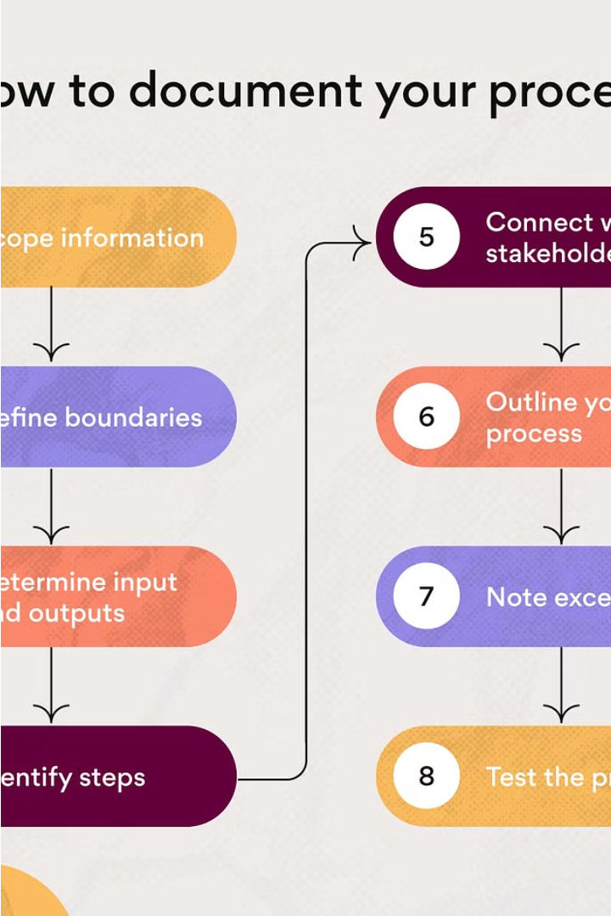
Documenting the Investigation
Thorough documentation is crucial throughout the investigation process. Detailed records must be maintained, including evidence logs, witness statements, and analysis findings. This ensures transparency, enables effective communication, and supports any future legal proceedings.
The investigation report should provide a clear and comprehensive summary of the process, findings, and conclusions. This report serves as the official record and supports decision-making and recommendations moving forward.

Slide 10
Recommendations and Next Steps
Implement Findings
Ongoing Monitoring
Based on the conclusions drawn from the investigation, develop an action plan to implement the necessary changes or solutions.
Establish a system to continuously monitor the situation and assess the effectiveness of the implemented recommendations.
Knowledge Sharing
Continuous Improvement
Document the investigation process and findings, and share them with relevant stakeholders to promote organizational learning.
Use the insights gained to identify areas for further improvement and refine the systematic approach for future investigations.

